Slide 1
FOSDEM Network
What is DNS64 and NAT64; and why should you care?

Slide 2
Who are we ?
Richard Hartmann – Network and project manager at Globalways AG
Peter Van Eynde – Cisco TAC – solving problems for a living
Andrew Yourtchenko – IPv6 Transition Engineer @cisco

Slide 3
WHY OH WHY ?

Slide 4
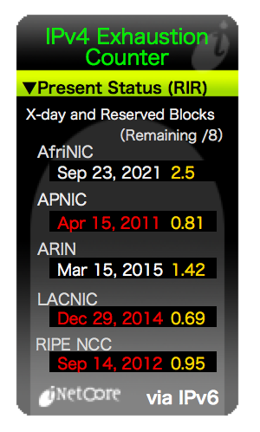
IPv4 has run out.

Slide 5
Also at FOSDEM !
Pool Wifi-client-dualstack :
Utilization mark (high/low) : 100 / 0
Subnet size (first/next) : 0 / 0
Total addresses : 4094
Leased addresses : 4093
Excluded addresses : 0
Pending event : none
1 subnet is currently in the pool :
Current index IP address range Leased/Excluded/Total
0.0.0.0 151.216.48.1 - 151.216.63.254 4093 / 0 / 4094

Slide 6
Also at FOSDEM !
Pool Wifi-client-dualstack :
Utilization mark (high/low) : 100 / 0
Subnet size (first/next) : 0 / 0
Total addresses : 4094
Leased addresses : 4093
Excluded addresses : 0
Pending event : none
1 subnet is currently in the pool :
Current index IP address range Leased/Excluded/Total
0.0.0.0 151.216.48.1 - 151.216.63.254 4093 / 0 / 4094
Pool Wifi-client-FOSDEM14 :
Utilization mark (high/low) : 100 / 0
Subnet size (first/next) : 0 / 0
Total addresses : 8190
Leased addresses : 853
Excluded addresses : 0
Pending event : none
1 subnet is currently in the pool :
Current index IP address range Leased/Excluded/Total
151.216.3.151 151.216.0.1 - 151.216.31.254 853 / 0 / 8190

Slide 7
Why not IPv5 ?
Internet Experiment Note IEN-119[1] (1979)
Never made it to public use
The version numbers are allocated only once

Slide 8
IPv6
64 bits in an address should be enough ?
We need variable length addresses !
(unlimited !)
No, it has to be fixed length
256 bits -> 2^256 = 1.15 * 10^77
Number of atoms in the universe: ~10^80
Too much !
Compromise: 128 bits

Slide 9


Problem
&

Slide 10
Mexican standoff
Clients
Content
Carriers
Applications
Hardware

Slide 11

World IPv6 day
Lets turn it on and see what breaks

Slide 12

World IPv6 launch
http://www.worldipv6launch.org/

Slide 13
Today’s production dualstack content
Google
Facebook
Yahoo
Youtube
Netflix
Akamai
Many many others

Slide 14

Where are the users ?
http://en.wikipedia.org/wiki/File:Oftheunicorn.jpg

Slide 15
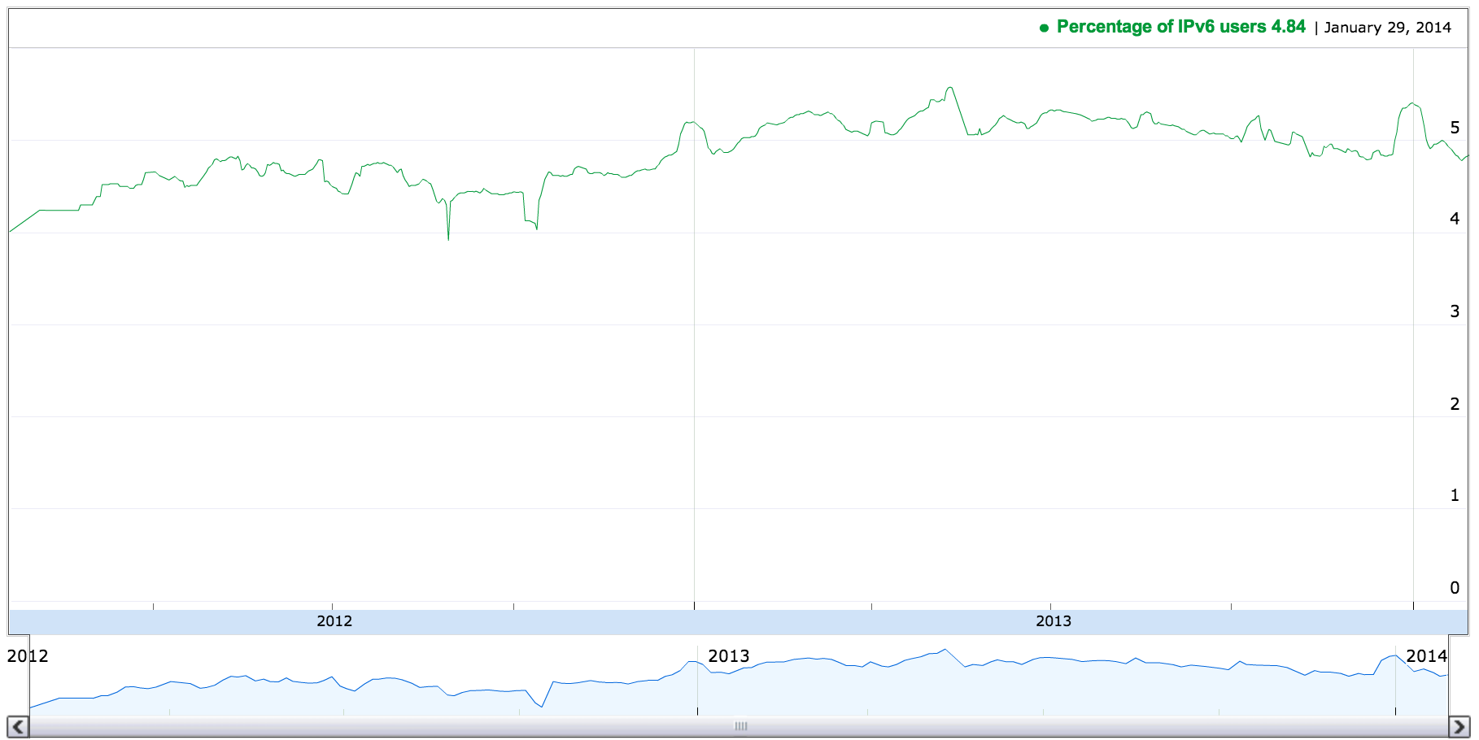
Country #1

Slide 16
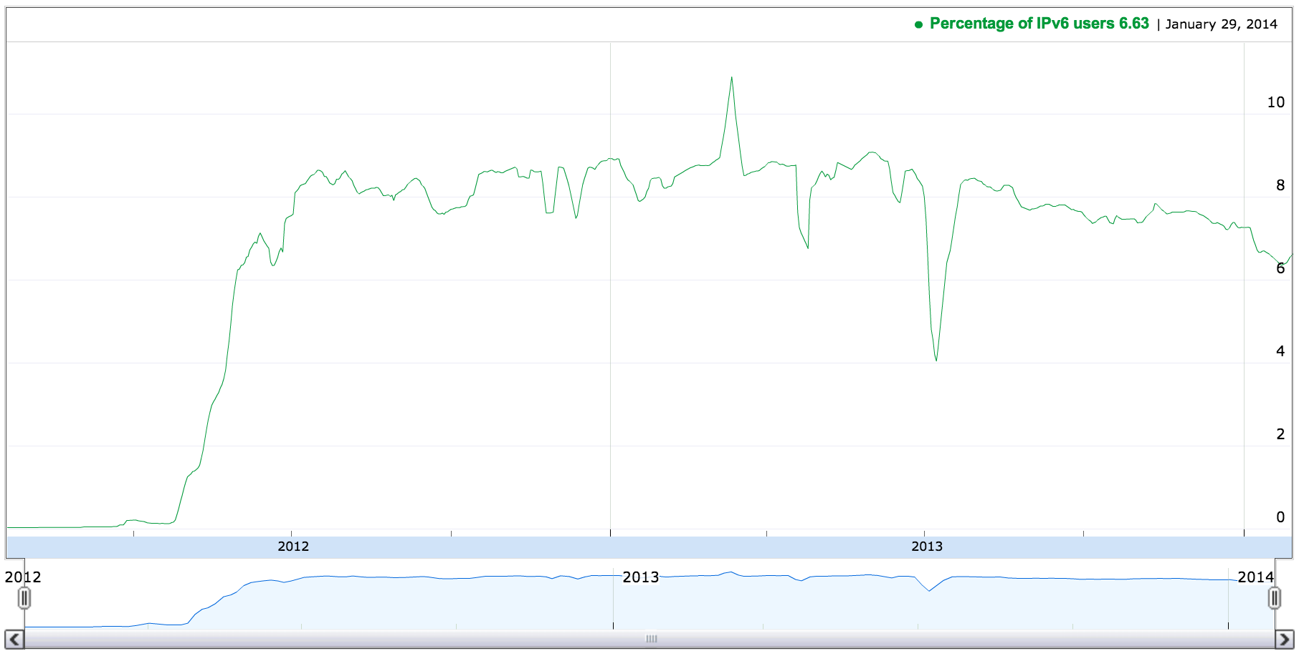
Country #2

Slide 17
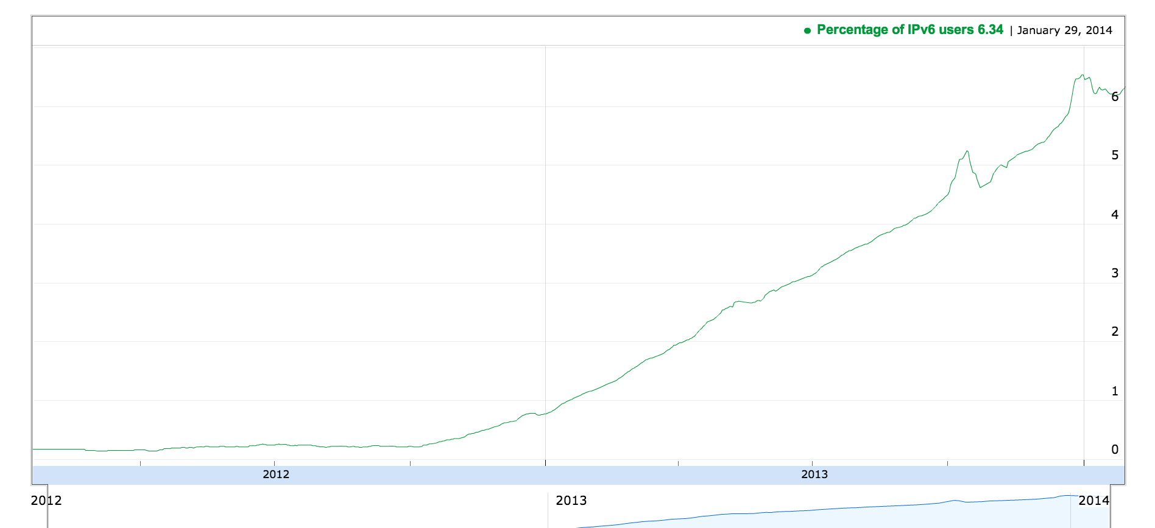
Country #3

Slide 18
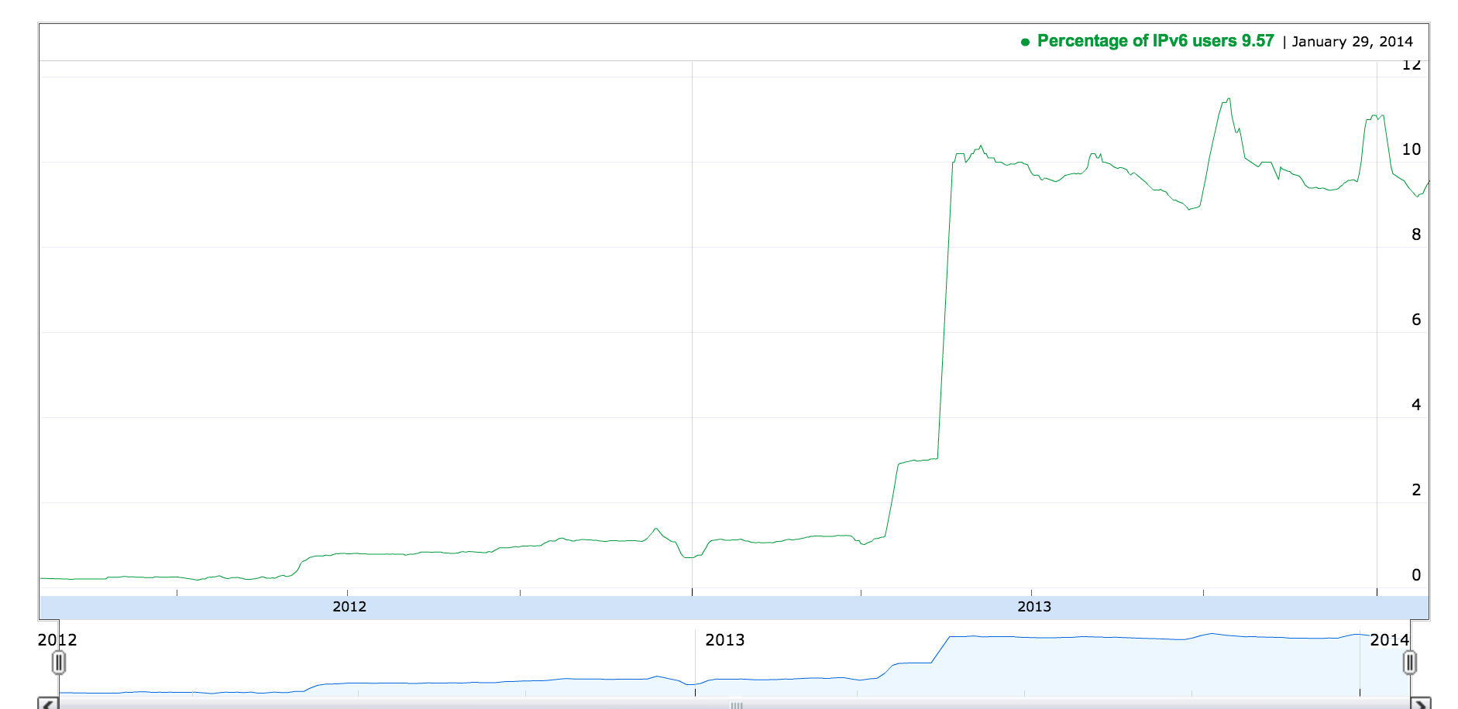
Country #4

Slide 19
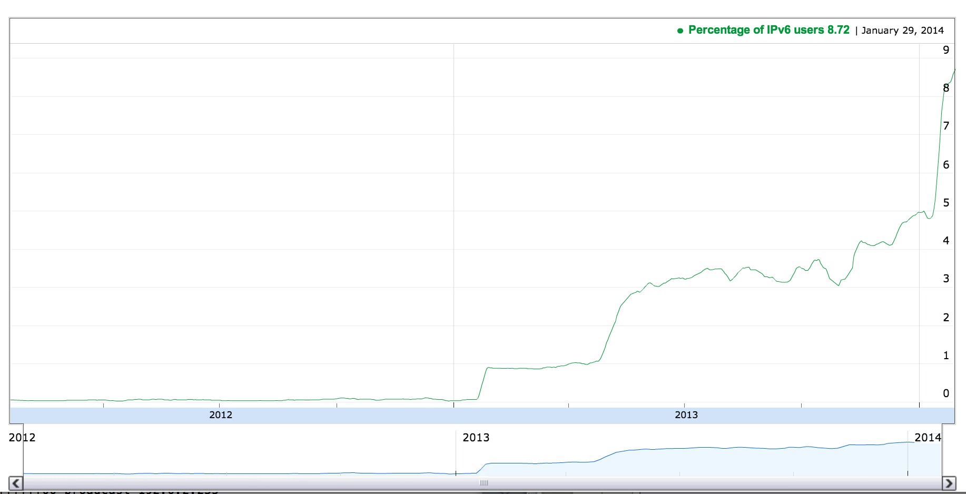
Country #5

Slide 20

Conclusion: unicorns definitely exist.

Slide 21
BUT THIS NOT ENOUGH !

Slide 22
IP at FOSDEM

Slide 23
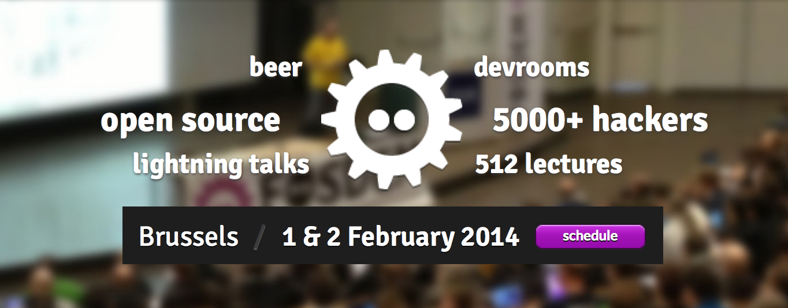

Slide 24
You are here

Slide 25
Time for the next step
Dualstack is working
As long as you have IPv4 addresses to spare
You don’t have them (Remember ‘why IPv6’?)
Need to run NAT anyway
One address space to manage
cheaper
Easier
faster
➔ Let’s switch off IPv4

Slide 26
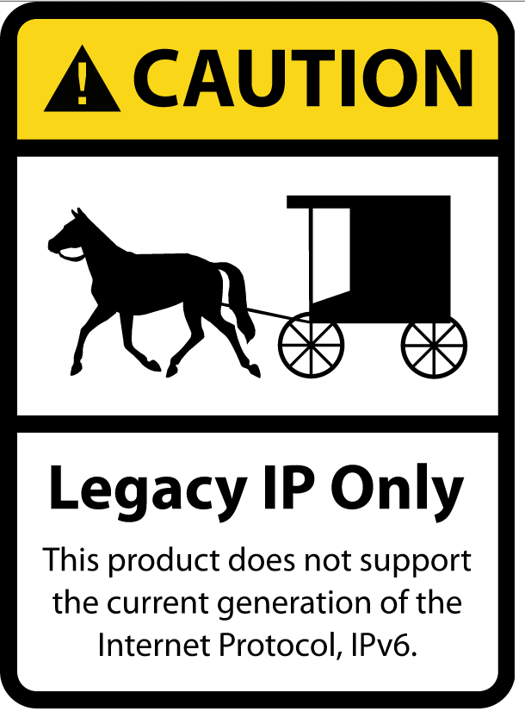
But what about legacy Internet ?
http://www.internetsociety.org/deploy360/blog/2013/07/the-legacy-ip-only-ipv6-horse-and-buggy-stickers-how-to-get-copies/

Slide 27
IPv6 space is big.

Slide 28
IPv6 space is big.
VERY BIG

Slide 29
How big ?
IPv6 space is denoted in blue
IPv4 space is denoted in red

Slide 30
Let’s zoom in: blue is a single /64 subnet
Home users typically get at 256 of these (/56)

Slide 31
We can hide a complete Legacy Internet in a /96 !
But how ?
Try to connect to http://guardian.co.uk/
DNS request AAAA & A records
Response with A only
Now what ?

Slide 32
We can hide a complete Legacy Internet in a /96 !
But how ?
Try to connect to http://guardian.co.uk/
DNS request AAAA & A records
Response with A only
Now what ?
YOU LIE !

Slide 33
DNS64
Pick an IPv6 prefix (there’s enough space!)
Map IPv4 into that space
Tell your DNS server to synthesize AAAA from the A records if no AAAAs are returned

Slide 34
DNS64
IPv6 prefix
2001:db8::/64
IPv4
0.0.0.0/0
IPv6-mapped
2001:db8::/96

Slide 35
DNS64 configuration on the BIND
/etc/bind/named.conf.options:
dns64 2001:db8::/96 {
clients { any; };
}

Slide 36

DNS64
www.legacywebsite.example ?
DNS64
DNS
www.legacywebsite.example ?
A: 192.0.2.1
IPv6-only Site
A: 192.0.2.1
AAAA: 2001:db8::c000:0201
IPv6
IPv4-only server
IPv6 Internet
192.0.2.1
IPv6 interface
IPv4
IPv4 interface
-w -pedantic: Several simplifications were made while creating this slide.

Slide 37
NAT64
asr1knat64#sh nat64 trans
tcp 192.0.2.1:80 [2610:d0:1208:cafe::c000:201]:80
153.16.17.82:1056 [2607:f128:42:73::2]:37897
2
IPv6-only Site
IPv4-only server
s: [2001:db8:72.163.4.161]:80
s: 153.17.16.82:1056
d: [2607:f128:42:73::2]:37897
IPv6
IPv6 Internet
d: 192.0.2.1:80
5
3
1
72.163.4.161
s: [2607:f128:42:73::2]:37897
4
IPv6 interface
d: [2001:db8::192.0.2.1]:80
IPv4
IPv4 interface
s: 192.0.2.1:80
d: 153.17.16.82:1056

Slide 38
RESULTS

Slide 39
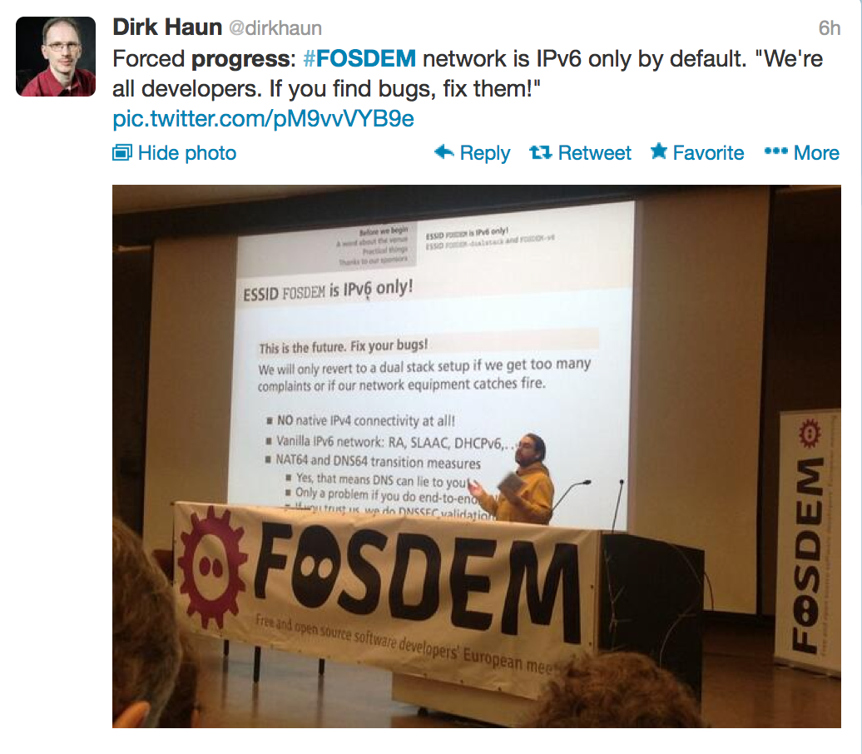

Slide 40
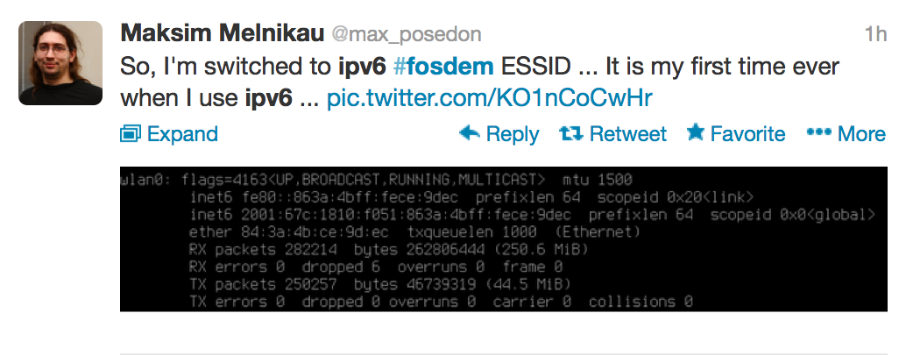

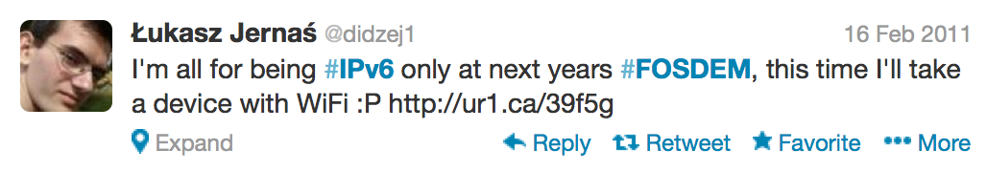

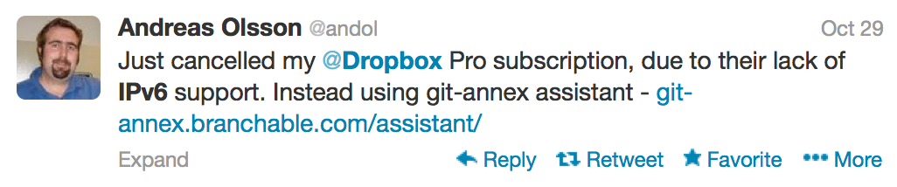

Slide 41
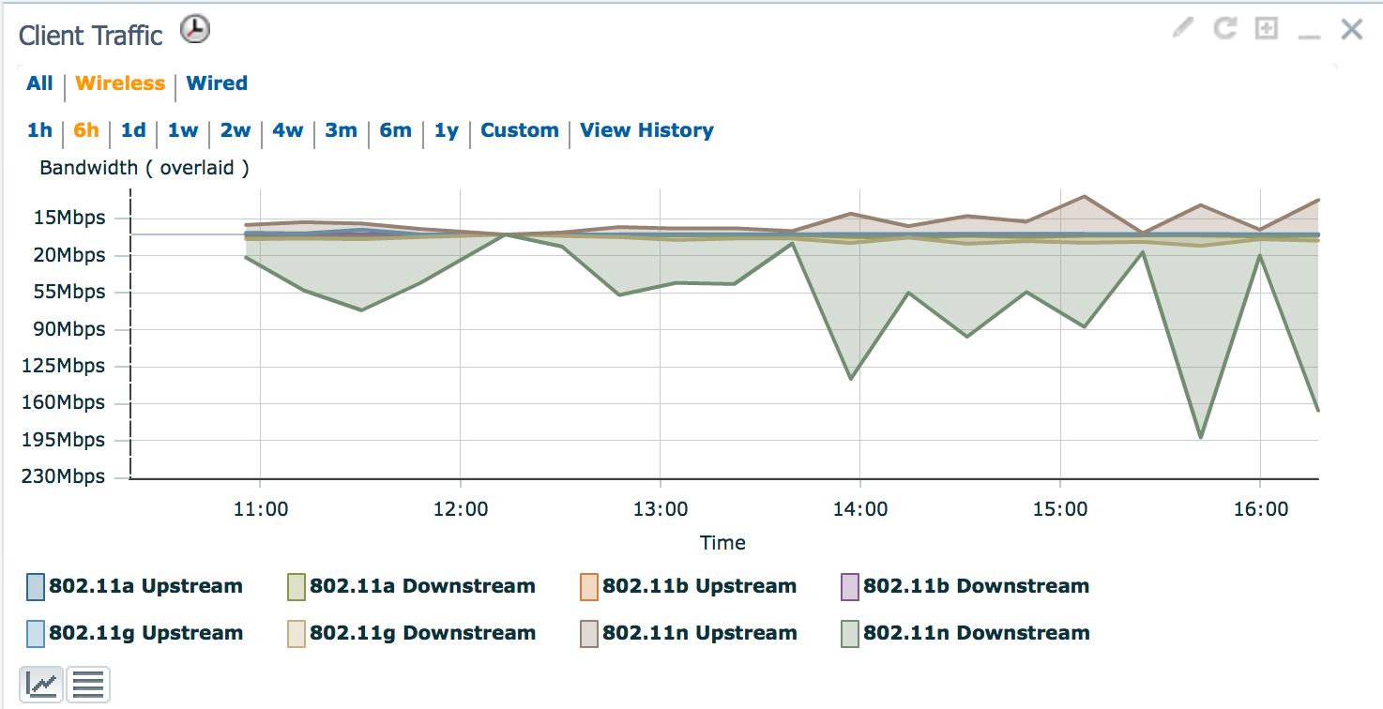

Slide 42
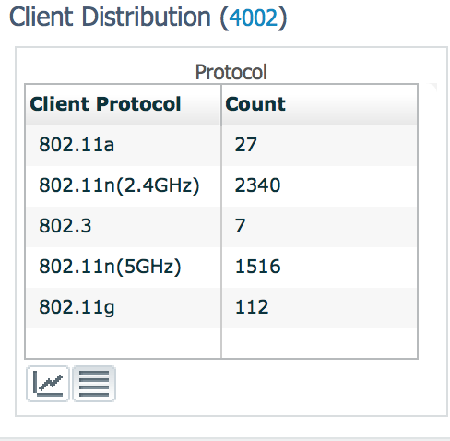

Slide 43
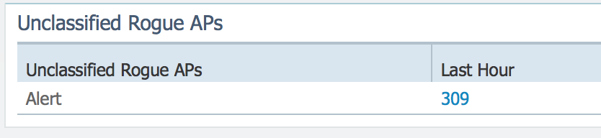

Slide 44
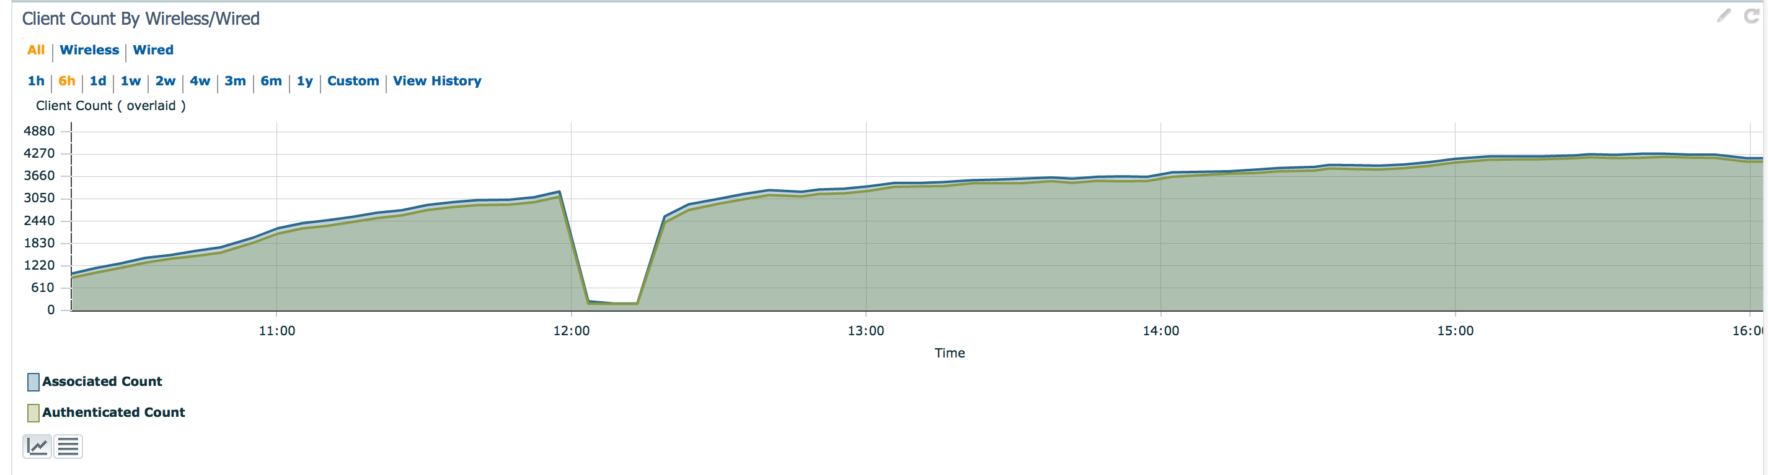

Slide 45
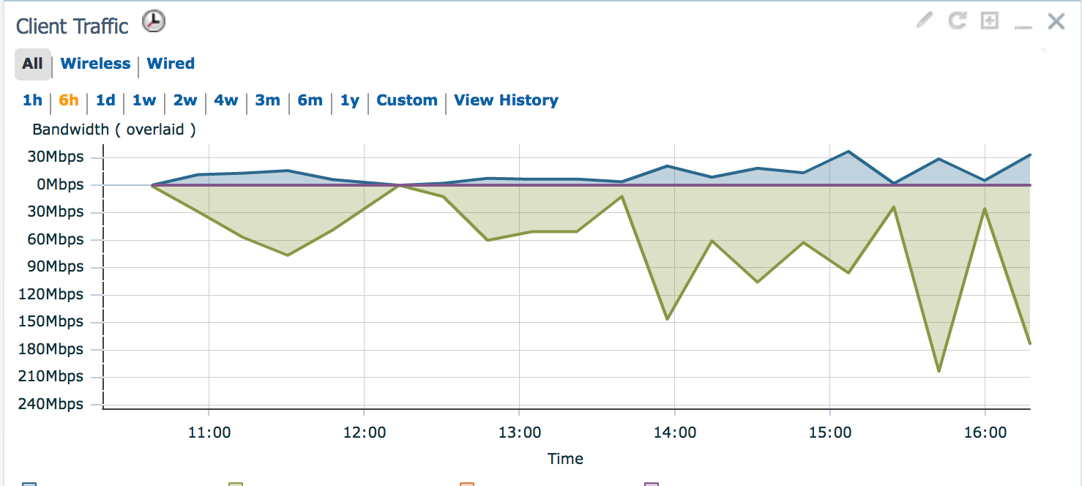

Slide 46
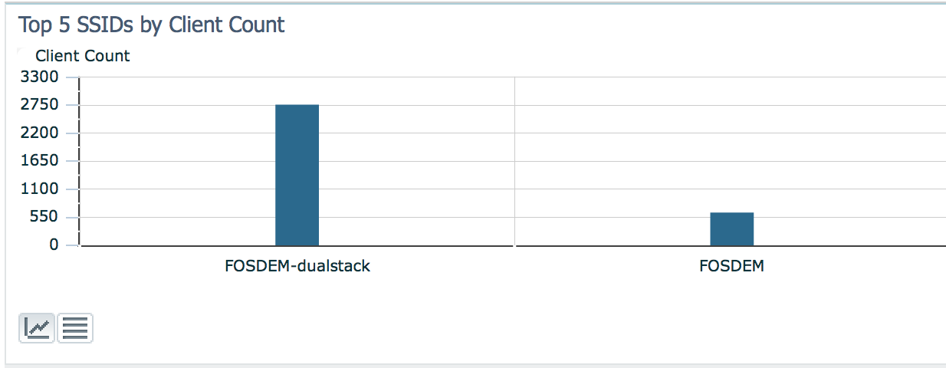
Clearly, this is not good enough.

Slide 47
FOSDEM’14 is the first general-purpose conference
With IPv6-only as a default
You all are part of history

Slide 48
Do we continue
tomorrow ?

